Slide 1

A Hybrid FE-EFG Method for 2D MIT Forward Problem Computation
Hassan Yazdanian
Department of Biomedical Engineering, K. N. Toosi University of Technology, Iran
Maedeh Hadinia
Department of Electrical Engineering, Langarud Branch, Islamic Azad University, Iran

Slide 2
Outline
Introduction
Mathematical model
Forward solver
Numerical experiments
Conclusion

Slide 3
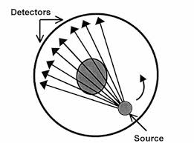
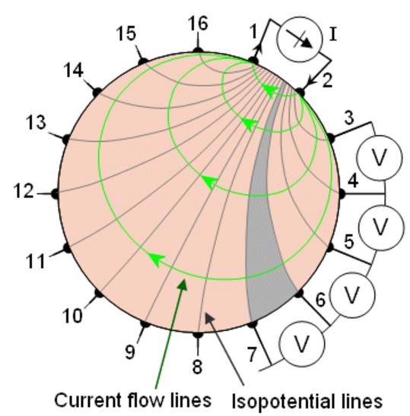
Introduction
Tomography methods ^{[1]}
Electrical tomography ^{[1]}
Hard-field tomography
e.g. CT and MRI
Soft-field tomography
e.g. Electrical tomography
www.kau.edu.sa
EIT: Electrical Impedance Tomography
ECT: Electrical Capacitance Tomography
MIT: Magnetic Induction Tomography
www.bem.fi/book/26/26.htm
Notes:
In the Hard-field tomography the excitation field lines almost propagate as straight lines whereas in the Soft-field tomography they diffuse in the medium. Due to this feature, the image reconstruction is much more difficult for the soft-field tomography.
Hard-field: expensive, non-portable, huge systems, invasive in some methods, time-consuming …. (High quality structural and fictional imaging)
All subclasses are non-invasive, non-destructive, non-radiative, low-cost, and portable…. (Poor spatial resolution due to limited number of measurements)
It should be noted that there is no conventional imaging modality for imaging of conductivity expect electrical tomography. (sample applications: Early diagnosis of breast cancer , EEG source localization , and targeting control in transcranial brain stimulation)

Slide 4
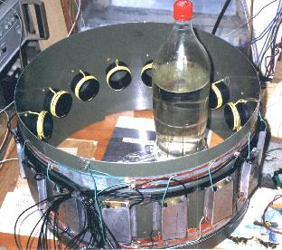
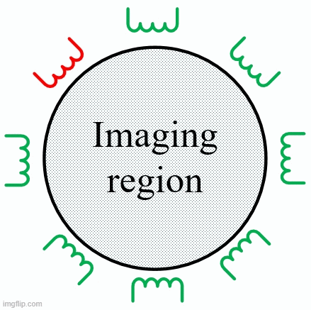
Introduction
Magnetic induction tomography (MIT)
MIT is a noncontact, noninvasive, and low-cost imaging technique for obtaining the distribution of conductivity inside an object.
A. Korjenevsky et al., Physiological Measurements, vol. 21, 2000.
Notes:
Here you can see a picture of one of the first biomedical MIT systems developed at Russian Academy of Sciences.
MIT is more advantageous than other electrical tomography methods:
1- it is difficult and in some cases impossible to attach EIT and ECT electrodes to samples under measurement [7].
2- MIT operates through an air gap, consequently, the difficulties with contact electrodes such as their unknown or variable impedance and position for EIT electrode [8] are avoided completely which yields to more accurate image reconstruction.
3-Unlike electrical field, magnetic field can penetrate high resistivity materials (e.g., skull and fat).
These advantages make MIT more attractive especially for applications in which the imaging region is inside a non-conductive shell.
MIT is capable of imaging all passive electromagnetic properties of martials; i.e. conductivity, permittivity, and permeability [9].

Slide 5
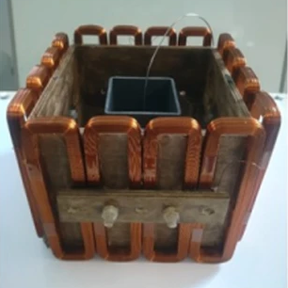
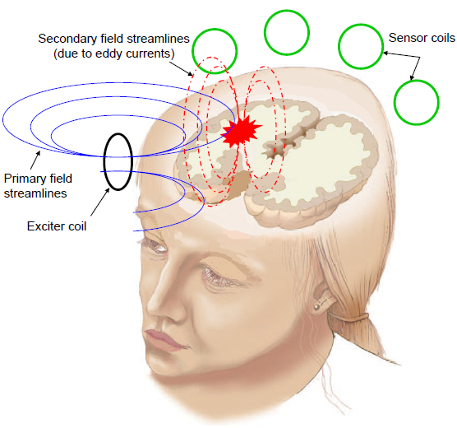
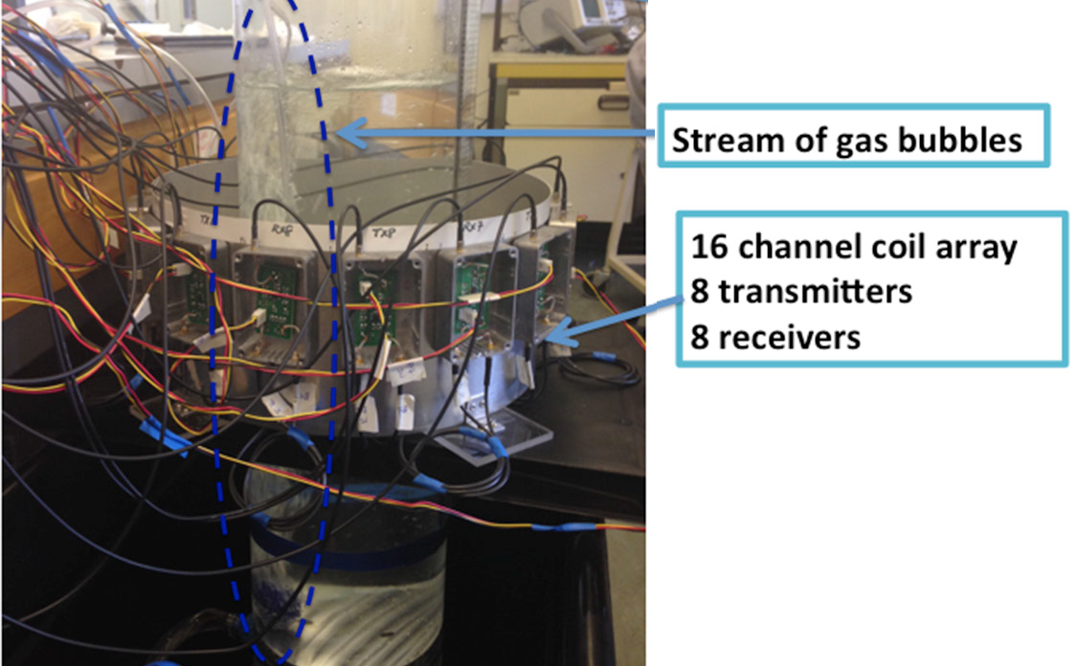
Introduction
MIT applications ^{[1]}
MIT applications
High-conductivity (>10⁶) applications
e.g. Imaging metal solidification
L. Ma et al., Scientific Reports, vol.7, 2017
Low-conductivity (<10 S/m) applications
e.g. Multi-phase flow imaging
and intracranial hemorrhage imaging
L. Ma et al., International Journal of Multiphase Flow , vol. 72, 2015.
M. Zolgharni et al, in “16th UK Conf. on Computational Mechanics, 2008
Notes:
Imaging metal solidification is a great example for which there is no real time monitoring technique at present.
In biomedical applications, conductivities to be imaged are less than 2 S/m. Therefore, the secondary magnetic field is generally much weaker than the primary magnetic field. This results in the weak voltages induced by the secondary magnetic field compared to the high conductivity applications.

Slide 6
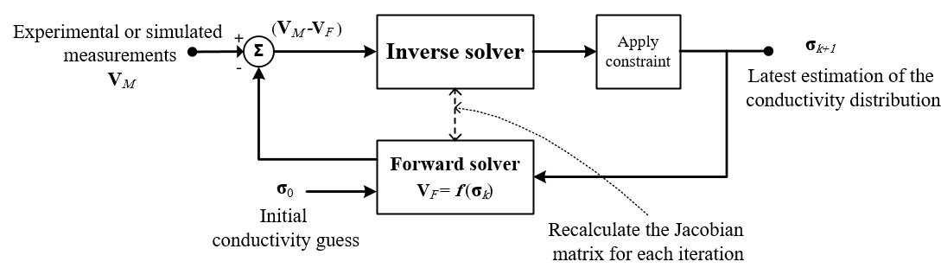
Introduction
Forward and inverse problems in MIT
A typical block diagram for conductivity image reconstruction in MIT ^{[2]}:
Forward problem model and forward problem solver should be highly accurate.
Notes:
Forward problem is a well-defined problem based on the Maxwell's equation with a unique solution. To achieve a reconstructed conductivity with a desired degree of accuracy, it is crucial to provide an accurate solution of the forward problem; since small errors in the forward model can generate considerable errors in the solution of the inverse problem.
On the other hand, the method for solving the forward problem should be computationally efficient. It is usually not possible to simultaneously achieve an accurate and fast computing method and a trade-off would be required. The methods that have been reported so far to solve the biomedical MIT forward problem can be classified to: analytical method, FEM, finite difference method (FDM), and other methods.
Image reconstruction in MIT is performed via the solution of an inverse problem to obtain an estimation of conductivity distribution inside an object. The MIT inverse problem usually is nonlinear, ill-posed, ill-conditioned, and underdetermined.
The nonlinearity in the problem arises from the fact that the measurements sensitivity to the conductivity distribution is a function of position in the imaging space. The sensitivity is high in the periphery of imaging space but dramatically decreases by going towards to the center. Furthermore, a local change in conductivity distribution affects all measurement channels.
The ill-posedness is explained based on the Hadamard definition which says a problem is well-posed if it has all of three conditions:
Existence: a solution must exist for the problem.
Uniqueness: the solution must be unique.
Stability: the solution depends in a continuous (stable) way on the observed data.
If the problem violates any of these requirements, it is ill-posed. Often for inverse problems including MIT, the first two criteria could be met, however third condition is problematic. Since small changes in measured data can often leads to large change in reconstructed conductivity.
Another difficulty arises when the MIT inverse problem is discretized and a small error in the measurements or simulations can result in much larger errors in the image reconstruction. This is quantified by the condition number of the Jacobian matrix which appears in the inverse problem. The condition number represents the ratio of the maximal to the minimal singular value of the Jacobian matrix. For the MIT inverse problem, the singular values of the Jacobian show a large decay towards zero giving large condition number. A problem with the large condition number said to be ill-conditioned.
In MIT, usually the number of unknown conductivity elements are much greater than the number of measurements. This causes the MIT inverse problem to be underdetermined.
Algorithms used to solve the MIT inverse problem can generally be grouped to linear single step algorithms and iterative algorithms.
As can be seen, the forward problem is an integral part of the conductivity reconstruction by MIT. With regard to difficulties of the MIT inverse problem such as ill-posedness and ill-conditioning, it is crucial to employ a highly accurate forward problem model to produce simulated voltages which can be fitted as well as possible to the measured data.
To reconstruct the absolute conductivity values, it is crucial to have a highly accurate forward model which can be fitted as well as possible to measured data in reconstruction process. A small error in the forward problem may seem negligible, whereas it can implicate considerable errors when it is entered in the process of inverse problem for image reconstruction.

Slide 7
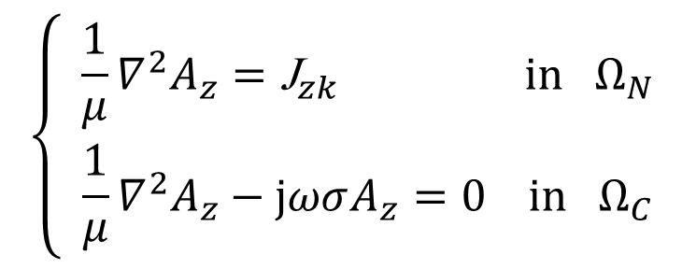
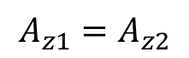
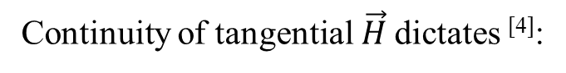
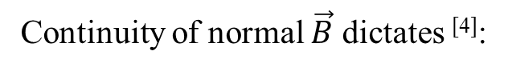
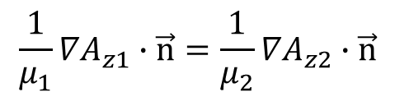
Mathematical model
Forward problem model
Forward problem formulation for 2D MIT ^{[3]}:
$$\left\{\begin{matrix} \frac{1}{μ}∇^{2}A_{z}={\text{J}}_{zk} in Ω_{N} \\ \frac{1}{μ}∇^{2}A_{z}−\text{j}ωσA_{z}=0 in Ω_{C}\end{matrix}\right.$$
Boundary conditions:
Continuity of normal $\vec{B}$ dictates ^{[4]}:
$$A_{z1}=A_{z2}$$
$$\frac{1}{μ_{1}}{∇A}_{z1}∙\vec{n}=\frac{1}{μ_{2}}{∇A}_{z2}∙\vec{n}$$
Continuity of tangential$\vec{H}$ dictates ^{[4]}:
At infinity, all the fields must vanish (far-field boundary condition).

Slide 8
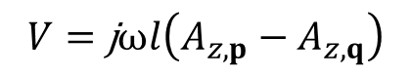
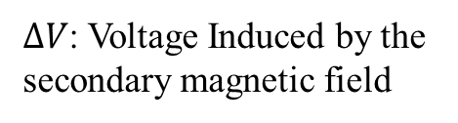
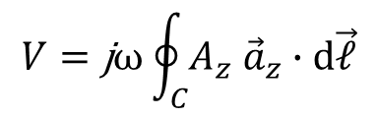
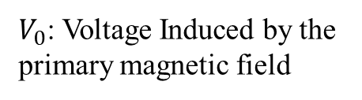
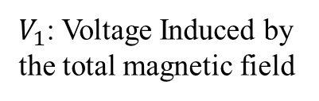
Mathematical model
Induced voltage
The output of forward problem is the induced voltages in sensing coils.
$V_{0}$: Voltage Induced by the primary magnetic field
$$V=\text{j}ω\oint_{C}{A_{z}{ \vec{a}}_{z}}∙d\vec{𝓁}$$
$ΔV$: Voltage Induced by the secondary magnetic field
$$V=\text{j}ωl\left(A_{z,p}−A_{z,q}\right)$$
$V_{1}$: Voltage Induced by the total magnetic field
Phasor diagram of induced voltage in a typical biomedical MIT system.

Slide 9
MIT forward solver
Analytical and numerical techniques are used to solve the MIT forward problem.
Numerical techniques are studied widely because of their high efficiency and good applicability.
The finite element (FE) method is one of the most typical and successful numerical methods used for solving the MIT forward problem.

Slide 10
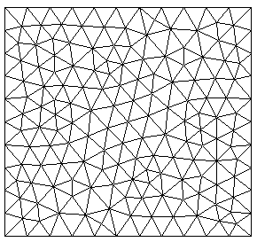
MIT forward solver
Challenges with FE method for medical applications
The reliance of FE method on a mesh leads to complications for certain classes of problems.
Using FEM in problems with complex geometries, like the human head in which generation of a mesh is a challenging task, may be problematic.
In some applications like imaging of lung ventilation, the shape and size of regions of the object under study are subject to frequent deformations. It can cause some difficulties for FE methods.
In some applications, large differences can be found in the geometrical properties of patient’s body like children or adults, men or women, etc.
Notes:
Since FE uses node connectivity (or element) in fixed geometries, it cannot be very efficient in these cases.

Slide 11
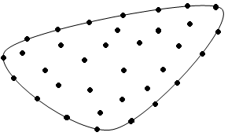
MIT forward solver
Element free Galerkin (EFG) method
In such applications, it may be superior to use mesh-less methods like element free Galerkin (EFG) method.
EFG method approximates an unknown function based on a set of nodes distributed in the problem domain, and does not need usual connection between nodes to construct discrete equations.
EFG method has not been employed to solve the biomedical MIT forward problem.

Slide 12
MIT forward solver
Challenges in EFG method
EFG method is computationally expensive!
Imposing the essential boundary condition in the EFG method is difficult!
FE method can be more efficient because of its effective treatment of boundary conditions and the direct way for assembling the stiffness matrix.
A combination of EFG the FE methods is preferred.
Hybrid FE-EFG method

Slide 13
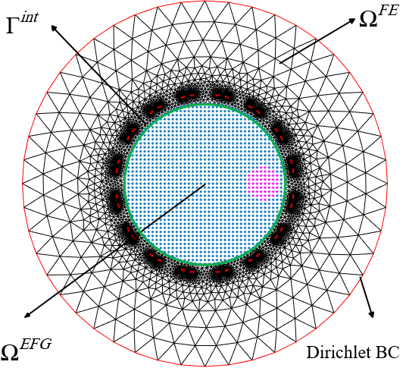
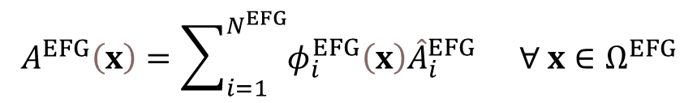
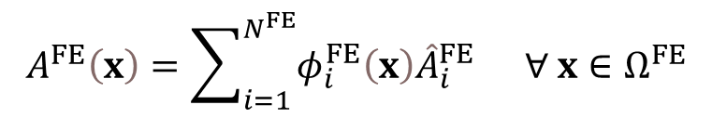
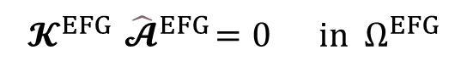
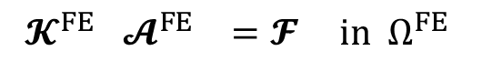
MIT forward solver
Numerical implementation
$$A^{EFG}\left(x\right)=\sum_{i=1}^{N^{EFG}}{φ_{i}^{EFG}\left(x\right){\hat{A}}_{i}^{EFG}} ∀ x∈Ω^{EFG}$$
$$𝓚^{EFG}{ \hat{𝓐}}^{EFG}=0 in Ω^{EFG}$$
$$A^{FE}\left(x\right)=\sum_{i=1}^{N^{FE}}{φ_{i}^{FE}\left(x\right){\hat{A}}_{i}^{FE}} ∀ x∈Ω^{FE}$$
$$𝓚^{FE } 𝓐^{FE } =𝓕 in Ω^{FE }$$

Slide 14
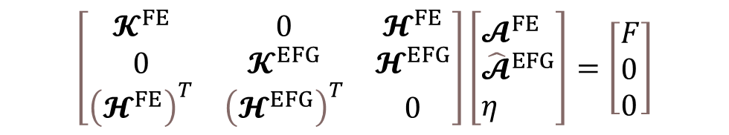
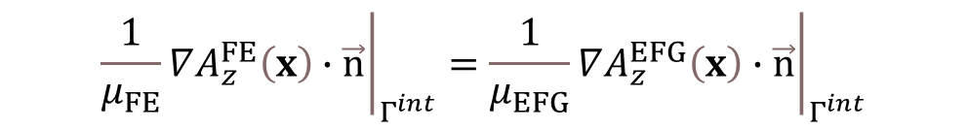
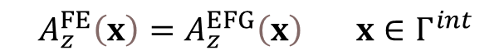
MIT forward solver
Numerical implementation
Continuity condition:
$$A_{z}^{FE}\left(x\right)=A_{z}^{EFG}\left(x\right) x∈Γ^{int}$$
$${\left.\frac{1}{μ_{FE}}∇A_{z}^{FE}\left(x\right)∙\vec{n}\right|}_{Γ^{int}}={\left.\frac{1}{μ_{EFG}}∇A_{z}^{EFG}\left(x\right)∙\vec{n}\right|}_{Γ^{int}}$$
$$\left[\begin{matrix}𝓚^{FE} & 0 & 𝓗^{FE} \\ 0 & 𝓚^{EFG} & 𝓗^{EFG} \\ {\left(𝓗^{FE}\right)}^{T} & {\left(𝓗^{EFG}\right)}^{T} & 0\end{matrix}\right]\left[\begin{aligned}&𝓐^{FE} \\ &{\hat{𝓐}}^{EFG} \\ &η\end{aligned}\right]=\left[\begin{aligned}&F \\ &0 \\ &0\end{aligned}\right]$$

Slide 15
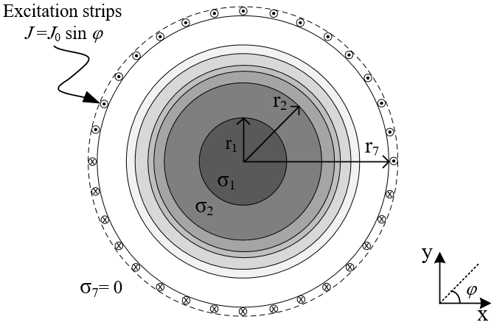
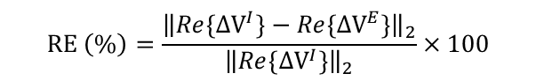
Numerical experiments
Benchmark test
method | FE | FE-EFG
RE (%) | 0.26% | 0.24%
Run time (s) | 0.17 | 0.29
$$RE \left(\%\right)=\frac{{\left\|Re\left\{{∆V}^{I}\right\}−{Re\{∆V}^{E}\}\right\|}_{2}}{{\left\|Re\left\{{∆V}^{I}\right\}\right\|}_{2}}×100$$

Slide 16
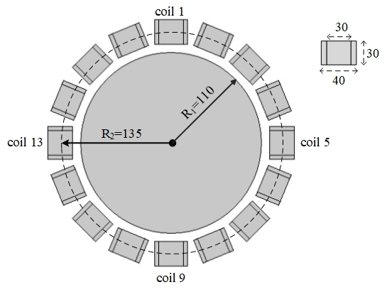
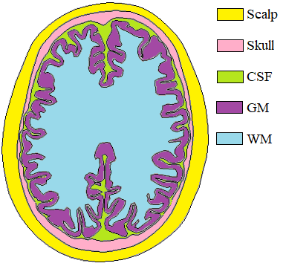
Numerical experiments
Head model
An extremely fine mesh was employed to solve the forward problem by the FE method as a ground truth.
method | FE | FE-EFG
RE (%) | 1.83% | 1.49%
Run time (s) | 4.80 | 3.67

Slide 17
Conclusion
An accurate solver based on the hybrid FE-EFG method was presented for MIT forward problem computation.
The solver benefits from advantages of both FE and EFG methods.
The method holds promise for solving MIT forward problem in domains with mesh difficulty task.

Slide 18
References
[1] Wei, H-Y., and Manuchehr Soleimani. “Electromagnetic tomography for medical and industrial applications: Challenges and opportunities [point of view].” Proceedings of the IEEE 101.3 (2013): 559-565.
[2] A. Peyton, “Electromagnetic induction tomography,” in Industrial tomography: systems and applications, M. Wang, Ed. Cambridge, UK: Elsevier, 2015, ch. 3, pp. 61-107.
[3] H. Yazdanian, R. Jafari, and H. Moghaddam, “Solution of 2D MIT forward problem by considering skin and proximity effects in coils,” IEEE Trans. Comput. Imag.
[4] L. Turner and H. C. Han, “The calculation of transient eddy-current fields using null-field integral techniques,” IEEE Trans. Magn., vol. 23, no. 2, pp. 1811-1818, Mar. 1987.

Slide 19
Thank you
Any questions?
Emails: hassanyazdanian@gmail.com
maedeh.hadinia@iau.ac.ir

